Slide 1
TEXT - TO – SPEECH
AND
SPEECH - TO – TEXT
RECOGNITION

Slide 2
Introduction:
Text to Speech (TTS) and Speech to Text (STT) uses machine learning techniques to simulate human speech from a textual representation and vice versa.
You can have any text read aloud in a voice that sounds as real as possible by utilizing TTS.
The real voice and audio file will be converted to text with the aid of STT.
With the help of this TTS and STT, voice robots like IVRs (Interactive Voice Response) and other dynamic announcements are made, which are incredibly useful for alerting systems.

Slide 3
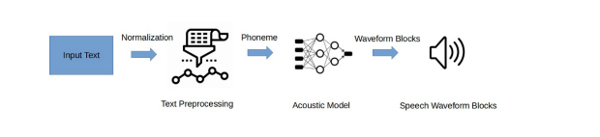
Text To Speech Architecture

Slide 4
Core Components:
For writing the code we have used
Python language
For Executing the script used
Jupyter Notebook

Slide 5
Text To Speech Capabilities
The user will be prompted to submit inputs into the code on request, such as the voice type, and volume(recommended : 1).
Depending on the user's interests, we can configure the audio’s rate of speech (recommended :100).
The system will read any text entered by the user and save the audio file where the user specifies.
There is no word count restriction, so we can enter as much text as we like.

Slide 6
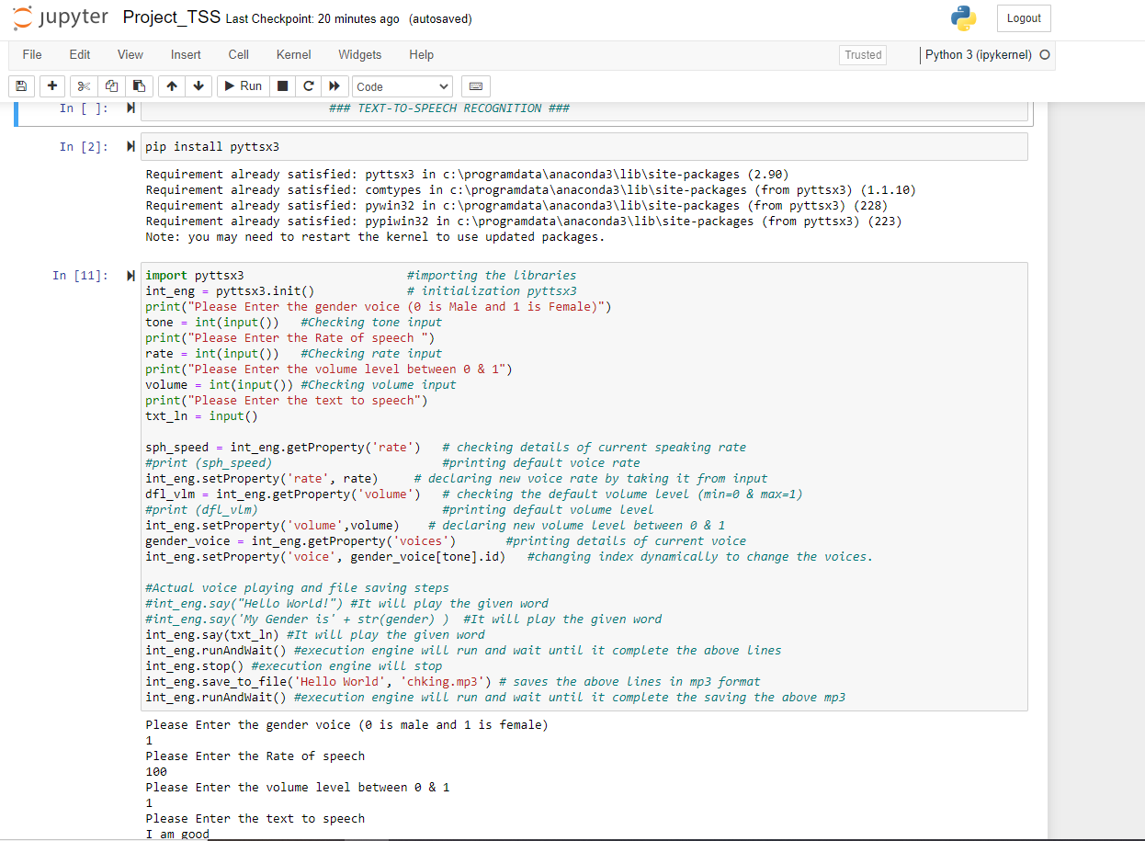
TEXT-TO-SPEECH CODE :

Slide 7
Speech To Text Capabilities
The code that has evolved has the ability to learn human speech and output it as text.
It could also verify the audio file and print the audio as text.
This code had a function that would process and pin the output of what was spoken after a little pause of a few seconds.
If your voice is not clear, this program contains a feature that will display a message such as "I apologize, but I didn't get data"

Slide 8
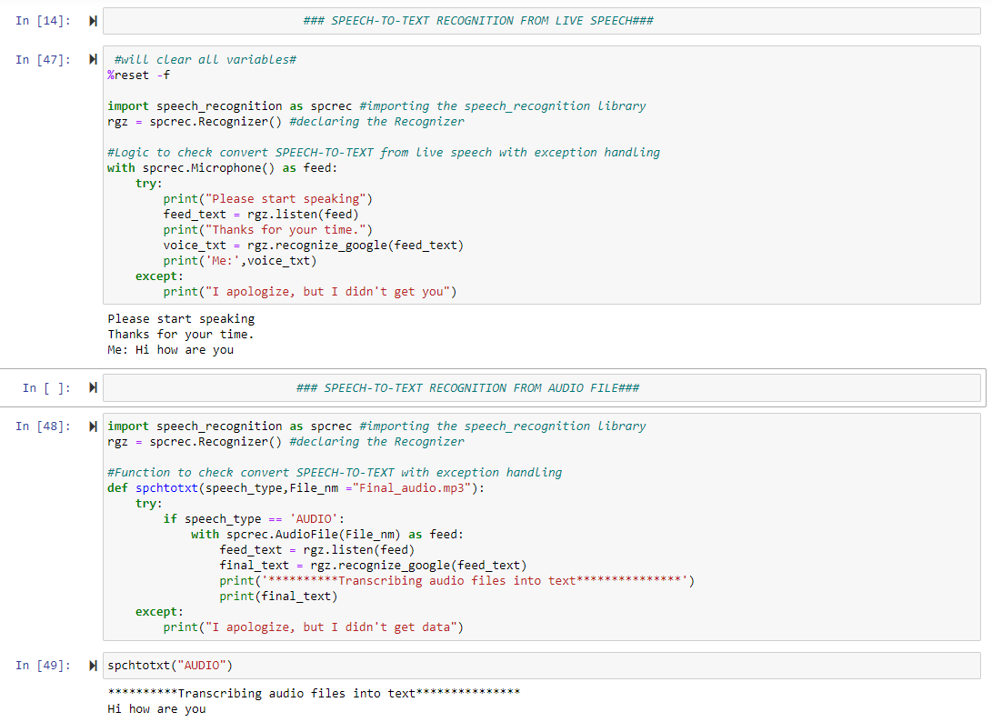
SPEECH-TO-TEXT CODE:

Slide 9
Characteristics of the code:
It had a capability of reading any text and delivering it in speech..
We have access to any type of gender voice..
We have the option of adjusting the voice pace by either accelerating or decelerating.
The voice volume is controllable.
It was able to record the desired word as an audio file and convert the audio file into text using speech-to-text logic.
Additionally, it has the ability to record live speech and convert it to text.

Slide 10
Internal Function of the Code:
Right now, Using the Python text-to-speech conversion package pyttsx3. It works offline and is compatible with Python 2 and Python 3 unlike other libraries.
As we are using the pyttsx3.init() factory method to obtain a reference to a pyttsx3 engine instance.
Using that instance, we have established an engine property using the command setProperty(name, value), which is used to declare rate, voice, and volume.
Used the syntax say(text: unicode, name: string). puts a request to speak a phrase in queue. The speech is output in accordance with the parameters established in the command queue preceding this one. and runAndWait() blocks while processing all commands that are currently in the queue.
Used syntax save_to_file(text,format) which will save word into an audio file and stop() will clear the command queue.
The audio file Speech to text and Realtime Speech to text processes are handled by the speech_recognition library.
Microphone() and AudioFile(FileName) were utilized as the audio sources, while listen() and recognize_google() were used to extract the audio data before formatting to text.

Slide 11
Thank You

